Slide 1

Customer Shopping Behavior Analysis
Analysis of 3,900 purchases to reveal spending patterns, segments, product preferences, and subscription behavior for strategic decisions.

Slide 2
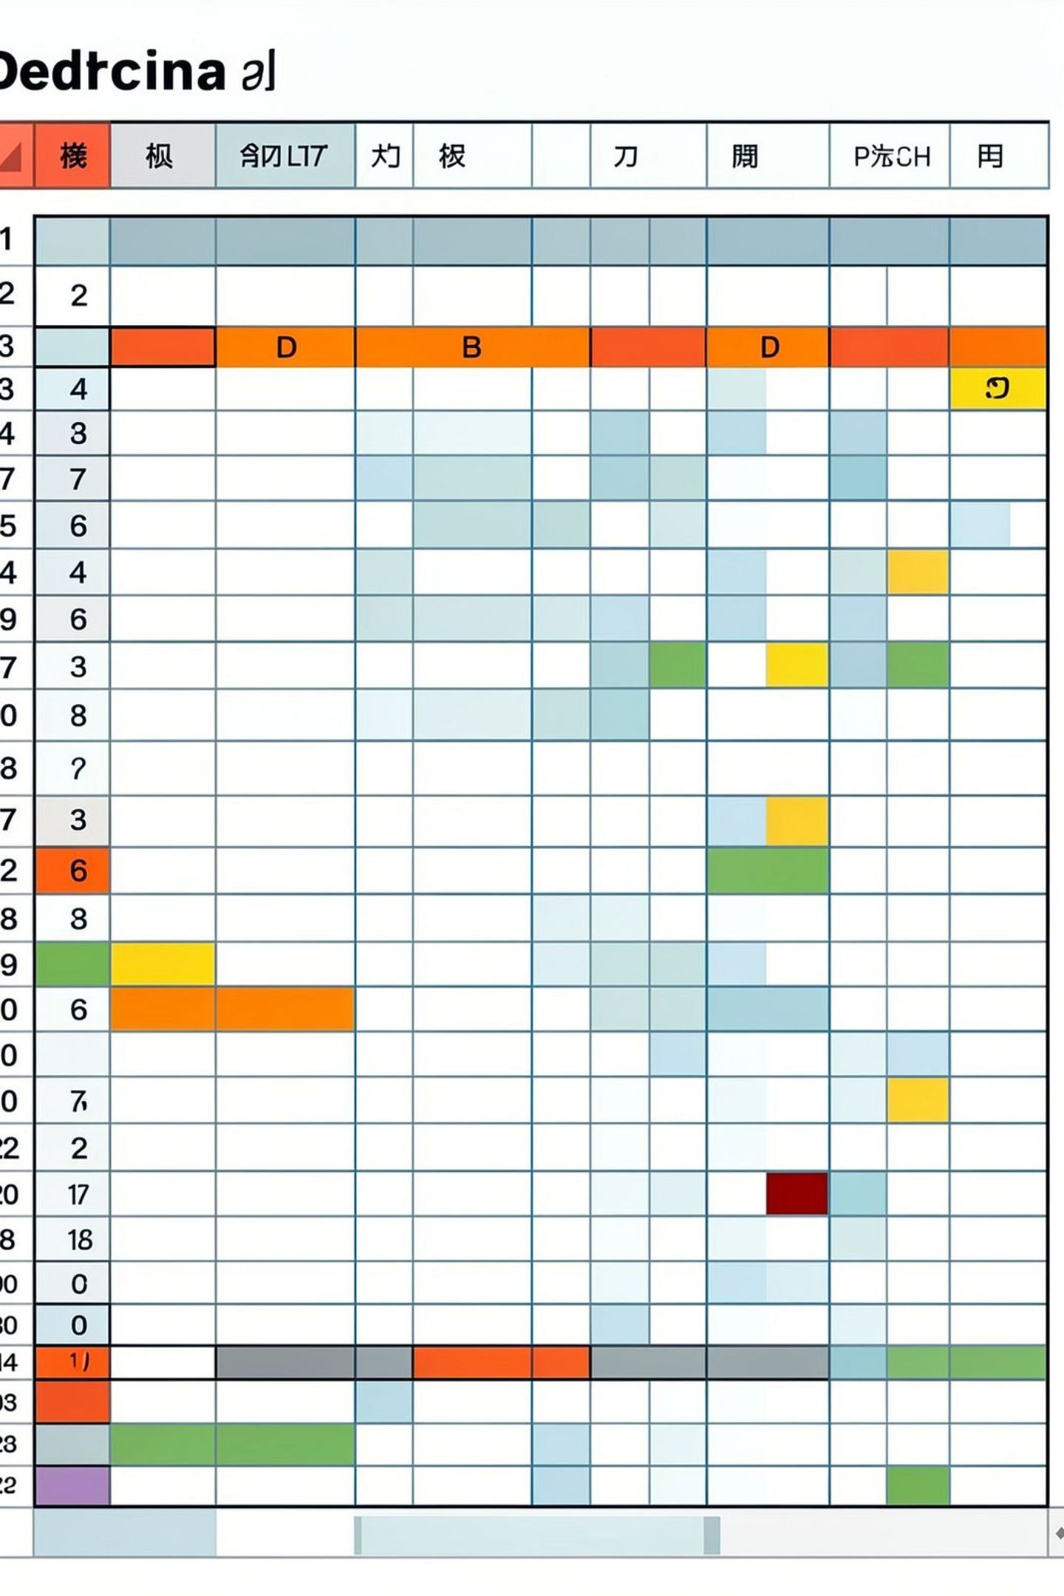
Dataset Snapshot
Size
Key Features
Missing Data
Rows: 3,900 • Columns: 18
Demographics, purchase details, behavior, subscription, shipping
37 missing values in Review Rating

Slide 3

Data Preparation Highlights
01
Cleaning
Imported with pandas; used df.info() and .describe()
02
Imputation
Filled Review Rating nulls with category median
03
Standardization
Renamed columns to snake_case
04
Feature Engineering
Created age_group and purchase_frequency_days
05
Deduplication
Dropped promo_code_used as redundant with discount_applied

Slide 4
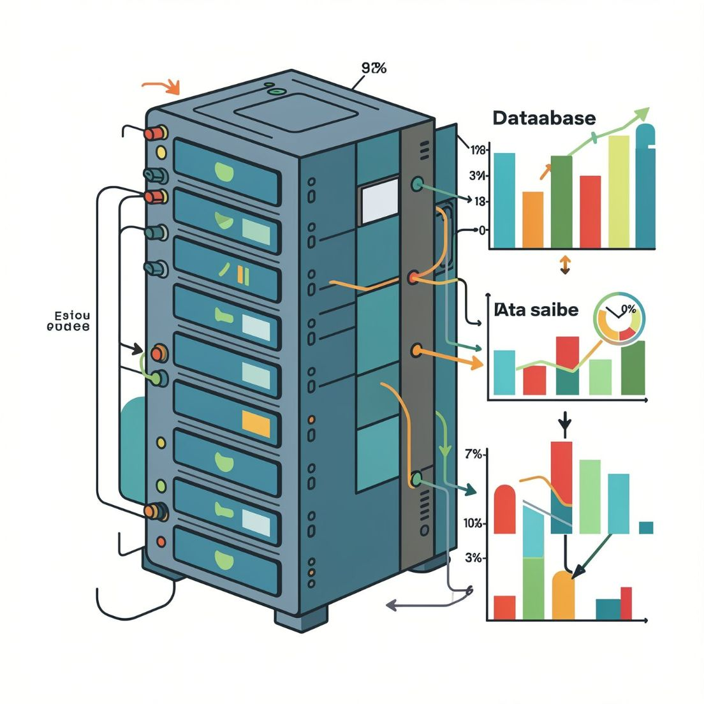
Database Integration
Cleaned DataFrame loaded into PostgreSQL to run business queries and support dashboard metrics.
Enabled SQL-level aggregation and segmentation
Faster reporting and reproducible analyses

Slide 5
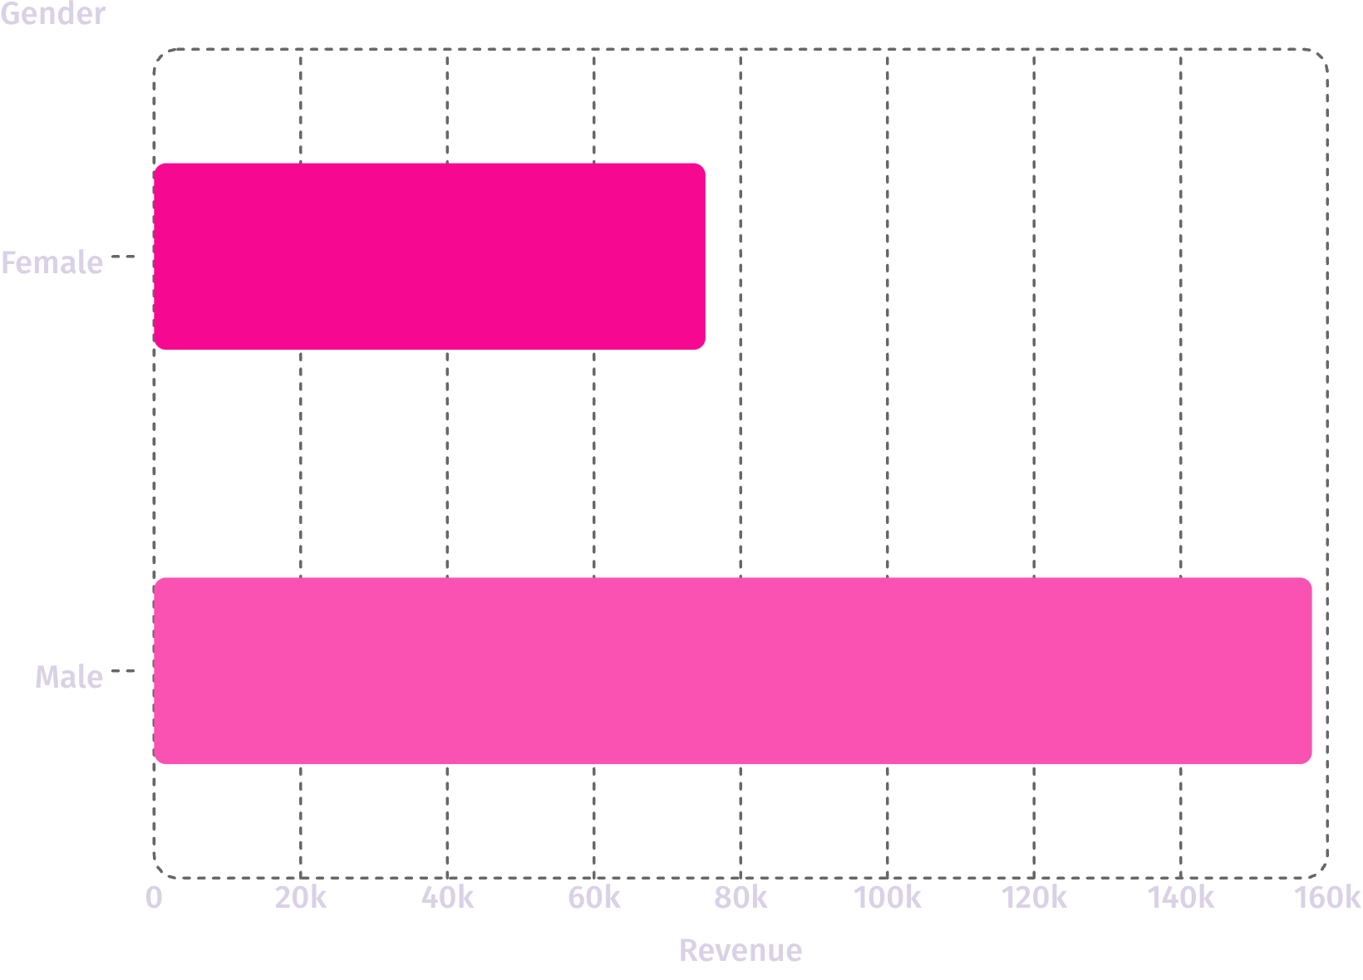
Revenue by Gender
Male customers generated higher total revenue in the dataset. Use gendered insights to refine promotions and product mixes.

Slide 6


Top Products & Discount Patterns
Top Rated
Discount-Dependent
Gloves
Sandals
Boots
Hat
Skirt
highest average ratings (≈3.78–3.86)
Hat (50%)
Sneakers (49.66%)
Coat (49.07%)
Sweater (48.17%)
Pants (47.37%) show high discount rates

Slide 7
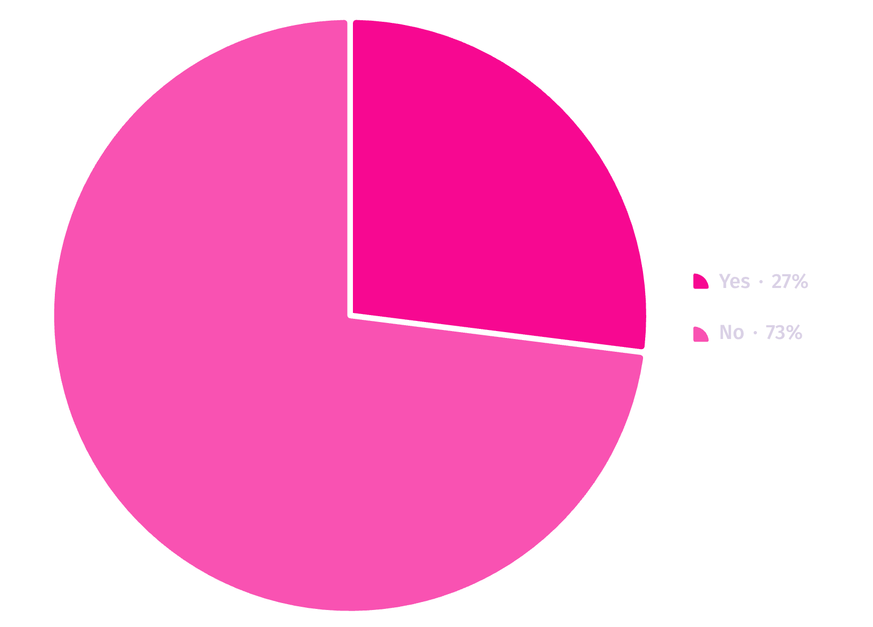

Subscribers vs Non-Subscribers
Avg spend: Subscribers $59.49 (total revenue $62,645) vs Non-subscribers $59.87 (total $170,436). Opportunity: increase subscriber conversion and ARPU.
Subscribers comprise 27% of customers (dashboard donut)

Slide 8



Customer Segments & Repeat Behavior
Loyal
New
Returning
3,116 customers — majority of the base
83 customers
701 customers
Repeat buyers with >5 purchases show higher subscription likelihood; reward programs can convert more repeat buyers to subscribers.

Slide 9
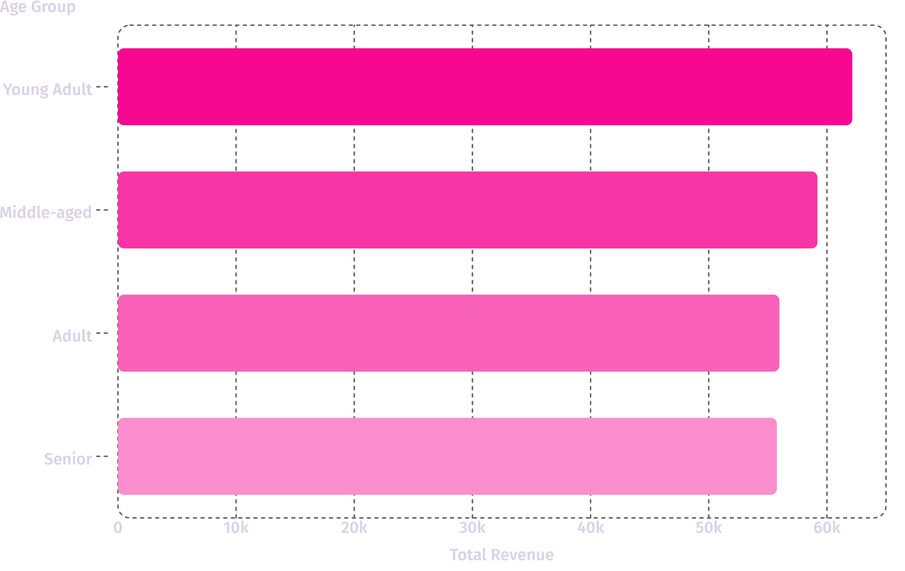
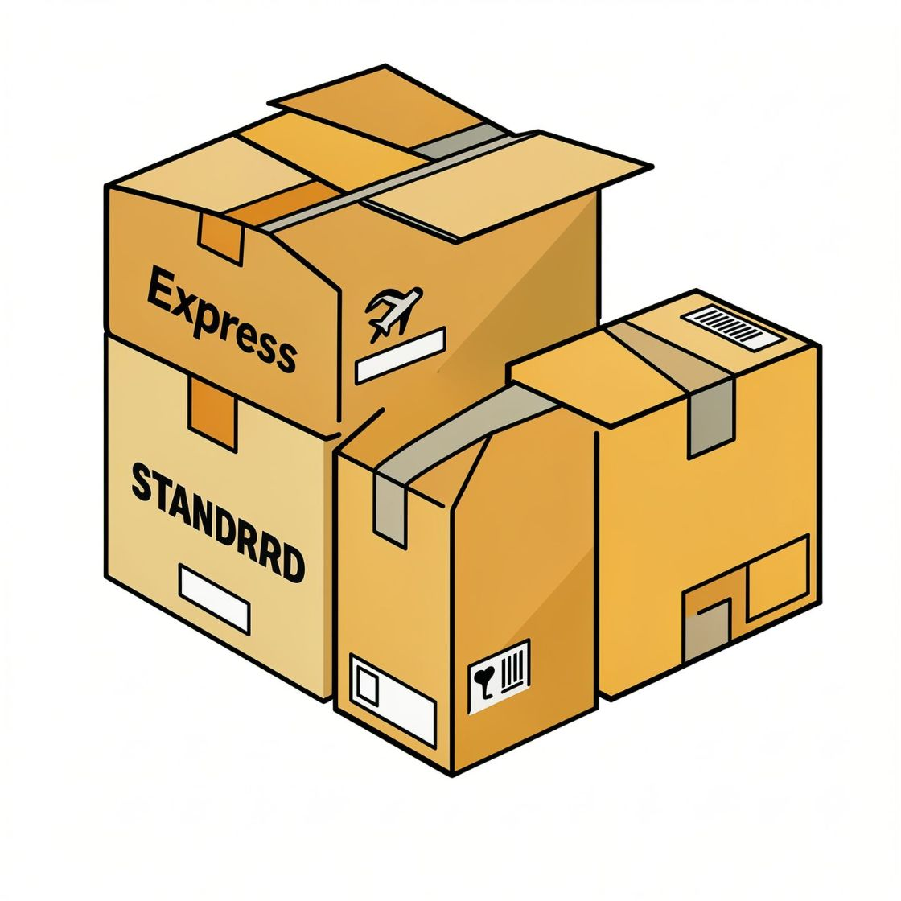
Age & Shipping Insights
Express shipping purchases have slightly higher average purchase amount ($60.48) than Standard ($58.46). Target marketing toward high-revenue age groups and express-shipping users.

Slide 10

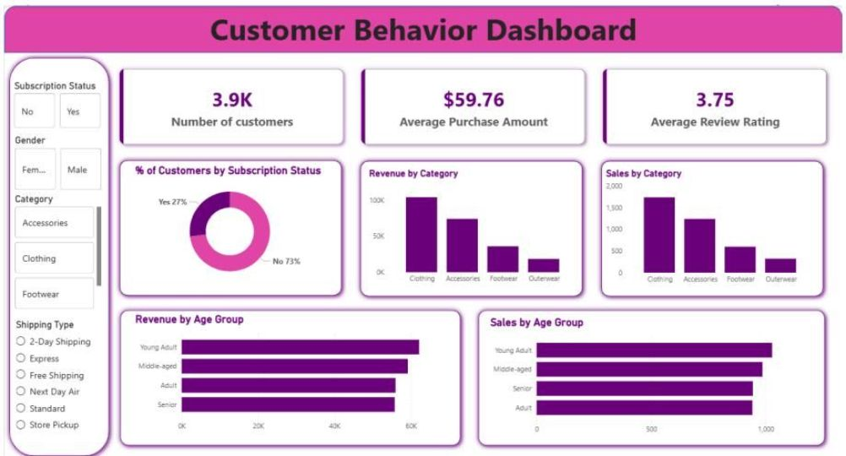

Dashboard Snapshot & Recommendations
Boost Subscriptions
Loyalty Programs
Review Discount Policy
Reward repeat buyers to grow the Loyal segment.
Promote exclusive subscriber benefits to increase conversion.
Balance discount-driven sales with margin control for discount-dependent products.
Product Positioning
Targeted Marketing
Feature top-rated and best-selling items in campaigns.
Focus on high-revenue age groups and express-shipping users.

